Slide 1
Web Programming Language
Week 12
React 3

Slide 2
Topics
UseEffect
APIs
Firebase
A To Do List

Slide 3
useEffect
Another Hook
Allows performing ‘side effects’ in components, such as fetching data, timers, updating the DOM

Slide 4
AddTweet
Import useEffect
import React, {useState, useContext, useEffect} from 'react’;
Add a function
useEffect(() => {
console.log('Render');
});
The function will run each time the AddTweet component is rendered

Slide 5
A Timer
Add a counter state
const [count, setCount] = useState(0);
Add a timer
useEffect(() => {
setTimeout(() => {
setCount((count) => count + 1);
}, 1000);
console.log({count});
});

Slide 6
Edit
If we want the function to only run on the first render;
useEffect(() => {
console.log('Render');
}, []);

Slide 7
Dependent on state or prop values
Will run when the ‘count’ changes
useEffect(() => {
setTimeout(() => {
setCount((count) => count + 1);
}, 1000);
console.log({count});
}, [count]);

Slide 8
Dependent on state or prop values
How about this?
useEffect(() => {
setTimeout(() => {
setCount((count) => count + 1);
}, 1000);
console.log({count});
}, [tweets]);

Slide 9
Initialising data
import React, {useState, useEffect, createContext} from 'react’ export const TweetContext = createContext(); export const TweetProvider = (props) => { const [tweets, setTweet] = useState([]); useEffect(() => { setTweet(JSON.parse(localStorage.getItem('tweets'))); }, []) return ( <TweetContext.Provider value={[tweets, setTweet]}> {props.children} </TweetContext.Provider> ) }
Empty Array
Get Data on first
render

Slide 10
Updating LocalStorage
Moving the setItem in AddTweet
useEffect(() => { localStorage.setItem('tweets', JSON.stringify(tweets)); }, [tweets])

Slide 11
Getting Data from an API
const API_URL = 'http://kencosh.com/calendar/calendar.php’; const [dates, setDates] = useState([]); useEffect(() => { const fetchDates = async () => { try { const response = await fetch(API_URL); const dateList = await response.json(); setDates(dateList); } catch (err) { console.log(err); } } (async () => await fetchDates())(); }, [])

Slide 12
Quick Project
A TO DO list
This time getting data from Firebase
(https://blog.bitsrc.io/build-a-todo-list-application-using-react-and-firebase-5ce2feba9489)

Slide 13
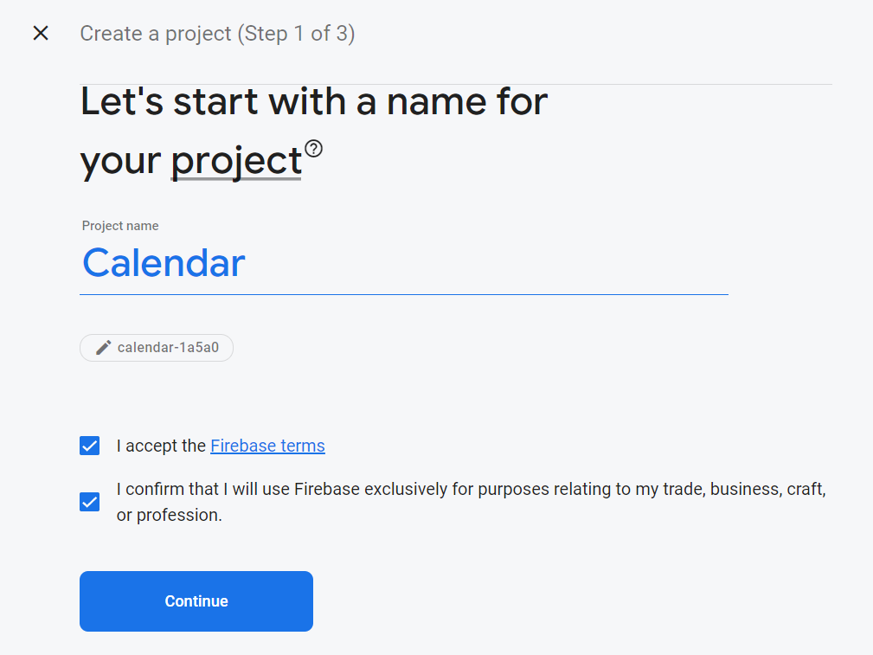
Firebase

Slide 14
Add App
To get firebaseConfig
Looks like:-
// Your web app's Firebase configuration const firebaseConfig = { apiKey: “string", authDomain: “string", projectId: “string", storageBucket: “string", messagingSenderId: “string", appId: “string" };

Slide 15
Set up new React App
Delete unnecessary files
Index.js
import React from 'react’; import ReactDOM from 'react-dom/client’; import './index.css’; import App from './App'; const root = ReactDOM.createRoot(document.getElementById('root’)); root.render( <React.StrictMode> <App /> </React.StrictMode> );

Slide 16
App.js
function App() { return ( <div className="App"> <h2>TO DO List</h2> </div ); } export default App;

Slide 17
Material UI
A Component library of UI tools
npm install @mui/icons-material
npm install @mui/material @emotion/react @emotion/styled
https://mui.com/
We will also need firebase
npm install firebase

Slide 18
App.js
import React, {useState} from 'react’; import {TextField , Button } from '@mui/material’; import './App.css’; function App() { const [todos,setTodos]=useState([ 'Study Algorithms’, 'Study Web’, 'Party’ ]); const [input, setInput]=useState(‘’); const addTodo=(e)=>{ e.preventDefault(); setTodos([...todos,input]); setInput(‘’) }; return ( <div className="App"> <h2> TODO List App</h2> <form> <TextField id="outlined-basic" label="Make Todo" variant="outlined" style={{margin:"0px 5px"}} size="small" value={input} onChange={e=>setInput(e.target.value)} /> <Button variant="contained" color="primary" onClick={addTodo} >Add Todo</Button> </form> <ul> {todos.map(todo => <li>{todo}</li>)} </ul> </div> ); } export default App;

Slide 19
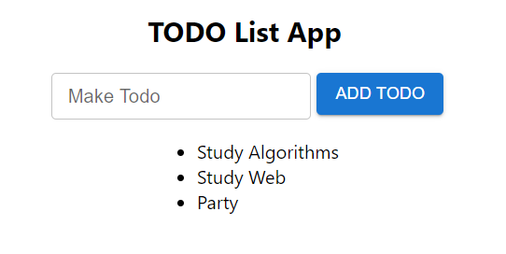
Starting To Do List
With some dummy state data

Slide 20
A ToDo Component
components/Todo.js
import { List , ListItem, ListItemAvatar, ListItemText } from '@mui/material’; import DeleteIcon from '@mui/icons-material/Delete’; import {db} from '../firebase.js’; import { doc, deleteDoc } from "firebase/firestore"; import './todo.css’; const Todo=({arr})=>{ return ( <List className="todo__list"> <ListItem> <ListItemAvatar /> <ListItemText primary={arr.item.todo} secondary={arr.item.todo} /> </ListItem> </List> )}; export default Todo;

Slide 21
Use the ToDo Component in App.js
Remember to import the Todo component!
<ul>
{todos.map(item=> <Todo key={item.id} arr={item} />)}
</ul>

Slide 22
Connecting to firebase
firebase.js
import { initializeApp } from "firebase/app"; import { getFirestore } from 'firebase/firestore’; const firebaseConfig = { apiKey: “…", authDomain: “…", projectId: “…", storageBucket: “…", messagingSenderId: “…", appId: “…“ }; const firebaseApp = initializeApp(firebaseConfig); const db = getFirestore(firebaseApp); export { db }

Slide 23
Connecting to Firebase
Create a Firestore Database
In Test Mode
Enable!
Start a Collection
Called ‘todos’
With a String field called ‘todo’
Any random value

Slide 24
UseEffect to get data from firebase
import React, {useState, useEffect } from 'react’; import {TextField , Button } from '@mui/material’; import Todo from './components/Todo’; import { db } from './firebase.js’; import { collection , onSnapshot } from 'firebase/firestore’; import './App.css’; function App() { const [todos,setTodos]=useState([]); const [input, setInput]=useState(‘’); useEffect(() => { onSnapshot(collection(db,'todos'),(snapshot)=>{ setTodos(snapshot.docs.map(doc => doc.data())) }) },[input]);

Slide 25
Add ToDo
const addTodo=(e)=>{ e.preventDefault(); addDoc(collection(db,'todos’),{ todo:input, timestamp: serverTimestamp() }) setInput(‘’) };

Slide 26
Tweak setTodos to use ids
useEffect(() => { onSnapshot(q,(snapshot)=>{ setTodos(snapshot.docs.map(doc=>({ id: doc.id, item: doc.data() }))) }) },[input]);

Slide 27
Add a Delete Icon
components/Todo.js
import { List , ListItem, ListItemAvatar, ListItemText } from '@mui/material’; import DeleteIcon from '@mui/icons-material/Delete’; import {db} from '../firebase.js’; import { doc, deleteDoc } from "firebase/firestore"; import './todo.css’; const Todo=({arr})=>{ return ( <List className="todo__list"> <ListItem> <ListItemAvatar /> <ListItemText primary={arr.item.todo} secondary={arr.item.todo} /> </ListItem> <DeleteIcon fontSize="large" style={{opacity:0.7}} onClick={() => {deleteDoc(doc(db,'todos',arr.id))}} /> </List> )}; export default Todo;

Slide 28
Add some style
Todo.js
.todo__list{
display:flex;
justify-content: center;
align-items: center;
width: 800px;
border: 1px solid lightgray;
margin-bottom: 10px !important;
}

Slide 29
App.css
.App {
display:grid;
place-items:center;
}

Slide 30
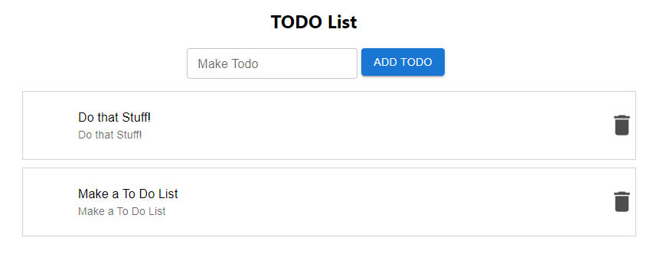
To Do!

Slide 31
Key Points
UseEffect can be used to connect to a server and collect data
Firebase is a cloud document store we can use to store our data rather than localStorage

